Slide 1
Please seat towards the front!

Slide 2
The heart of the ACT therapeutic stance
Robyn D. Walser, Ph.D. & Lic. Manuela O´Connell
Notes:
3.15
the remaining question is? how do we train in the ACT therapeutic stance?
as the progression we did last year it need
1) self awareness and being open aware and angange to our own processes
2) awareness of how we impact other people from therapeutic stance in spite of what we say. exercise 2.
3) how we impact interpersonally with what we say. self as context in general exercise as you guided las year
and we can do and exercise on being bold and speak the truth from the heart

Slide 3
Objectives
Discuss how to be more context sensitive and track consequences of therapist behaviours.
Create a context in which participants will be able to use an open, engaged and committed stance.
Notes:
It is kind of a logical progression around that the therapeutic stance is around
- Self awareness, mindfulness our inside landscape
- Awareness on how we relate to experience, quialities of embodied presence like openess curiosity integrating and evoking ( took them from mat villate work).
- embodied presence and interpersonal mindfulness, how we are seen by the other and how do we impact in the other.
- awareness of our verbal presence, awareness of sticky notes.
- self as a context awareness of therapist and client
Being bold

Slide 4
What is the ACT therapeutic stance about?
Notes:
Open discussion
What ideas do they have about the ACT therapeutic stance?
How is it different from other therapies?
Is something everyone does?
Some points to mention around that discussion are that:
It is important to take ACT on yourself
The client is capable and responsible
Genuine relationship and clarification on what do we mean by genuine. And authenticity.
Compassion with wisdom
Softly confrontational
WE want OPEN AWARE and ACTIVE therapists.

Slide 5
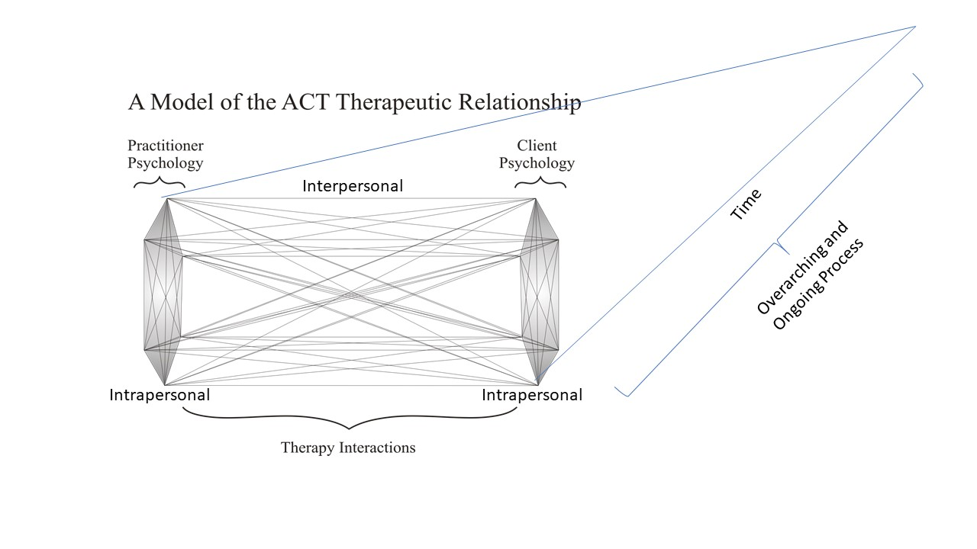
Notes:
In Figure 1 below, the model of the ACT therapeutic relationship is depicted. The most important part of this figure isn’t the two hexaflexes drawn at each end, it is the lines drawn in between. They represent fluidity and interconnectedness. The 6 core processes are linked to the other six and flowing between client and therapist. When this is working masterfully, you can observe an entire session, that is ACT consistent, yet hasn’t a single exercise, designated protocol or specified tool in it.

Slide 6
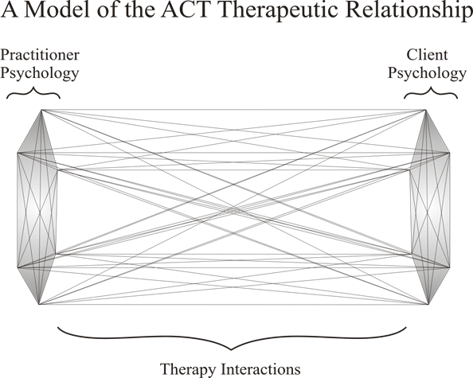
YOU
Notes:
What the therapist brings to this process.
What you bring is bigger than the 6 act processes

Slide 7
Stance
Defined in Two Ways
Both are Relevant
An adopted position with respect to experiencing mental or emotional events
As a “position of the feet.”
It is a place occupied by experience and body

Slide 8
The ‘adopted’ stance
Requires awareness
Is Intimately linked to the ACT Core Competencies for the Therapeutic Relationship
The ACT therapist
Notes:
Create a word collage
Link to the core competencies
Highlight the words
Speaks to the client from an equal, vulnerable, compassionate, genuine, and sharing point of view
Is willing to self disclose about personal issues when it serves the interest of the client vulnerable equal
Avoids use of “canned” ACT interventions, is flexible and ready to change course discloses
Tailors interventions/behavioral tasks to fit the client’s experience, language practices, social, ethnic, and cultural context
Models acceptance of challenging content compassionate genuine sharing discloses
Always brings the issue back to what experience compassionate genuine sharing
Introduces experiential exercises, paradoxes, and/or metaphors as appropriate
Uses ACT relevant processes in the moment and in the context of the therapeutic relationship

Slide 9
The “position of the feet”
Is explored through being bold - taking action, stepping forward even when difficult
Is about speaking from the heart - connecting to self and other at the level of feeling with an authentic, simple, and sincere presence

Slide 10
The ACT therapeutic stance is and can be cultivated
It entails bringing:
Awareness and compassion to your own experience
Stepping forward in your life; and
Holding that others can do the same
It is embodied and it is about presence
You are “communicating” that you are firmly here. Like the presence of a tree. Solid and firmly rooted in the ground, it does not lose its “treeness” despite the changing seasons and weather. It is here - present. You are whole and nothing can be said or felt that strips that wholeness. You remain rooted.
Notes:
The ACT therapeutic stance is and can be cultivated and begins, as we explored in Part I of this book, with personal practice. It entails bringing awareness and compassion to your own experience as well as stepping forward in your life; and holding that others can do the same. As an adopted position, it is embodied and it is about presence. You are “communicating” that you are firmly here. The best metaphor I can think of to represent presence is that of a tree. Solid and firmly rooted in the ground, it does not lose its “treeness” despite the changing seasons and weather. It is here - present. This embodied stance then, is about a full connection to self-as-context. You are whole and nothing can be said or felt that strips that wholeness. You remain rooted.
This sense of presence is instantiated by selecting willingness (i.e., I choose to be willing) and engagment from the larger sense of “I”. You can carry this presence across therapy in general and you can bring it to each moment. I am willing over time and I am willing here and now. This presence can be seen and felt in those here and now moments when a client expresses deep or difficult emotion and the therapist is able to be open and still.

Slide 11
The stance is interwoven, tied together – feet and heart - in whole cloth by the threads of what it means to engage in a relationship designed to compassionately support another being in creating a meaningful life.

Slide 12
Today’s Focus: The ACT Experiential Stance
Openness
Curiosity
Engaged
Notes:
3.25
Engage includes ENCAPSULATE AWARENESS AND BOLDNESS
Mathew Villate
Integrating rather than contradicting
Evoking rather telling
And the core competencies

Slide 13
SELF AWARENESS
The therapeutic stance involves being able to recognize your personal capacity to be open, aware, and engaged in the therapy
It means understanding your behavior, knowing when you are fused, avoidant, or out of touch with your values
But self-awareness also means being connected to and aware of how others perceive you and the impact of your behavior on others, in the moment, and across time.
Exercise: Self-Awareness expanded
Notes:
Manuela
15 min.
Extend this exercise to an interpersonal mindfulness exercise. Mindfulness exercise that cultivates openness and curiosity. Small mindfulness meditation of awareness what is here and now also incorporate the perspective of other seeing you
Atmosphere that you emanate
AWARENESS
Practicing self-awareness is also beneficial in that it can assist you in discerning when to act on experiences in relation to how you are perceived by others and in recognizing your impact on other.
In our personal awareness practice, we may turn to some of the more common efforts such as awareness to the breath or body. We may focus on the five senses or observe our own thinking or that we think. We are less often, it seems, mindfully aware of how we are perceived or of what our impact is on others. Self-awareness in the ACT therapeutic stance entails both. Exploring impact on other is informative to your stance. A closer look at self-awareness and relation to other is useful.
perspective taking
self-reflective perspective - you seeing you. Observing how you respond in different interpersonal contexts and the workability of those responses (again noticing your own antecedents, behavior, and consequences), being aware of your emotions, thoughts, behaviors, etc. will guide you in considering the kinds of choices you would like to make based on what you learn, both in your personal relationships and in therapy.
You “stepping into” someone else seeing you.

Slide 14
2. DISCOVERING YOUR EMBODIED STANCE
In pairs.
One is the therapist
One is the client
The therapist does what they know to do with the client and practices self awareness. The client notices the embodied therapeutic stance.
Notes:
3.42
Manuela 5 and 3 min
Exercise around shaping the ACT stance
Suggestion
Being able to see an interaction and read non verbal cues of the stance
Have feedback from client
Client: What I sensed from you, what I intuited from you, what I saw-felt from your body language
AWARENESS of impact exercise, cultivating greater interpersonal awareness
Whatever the case, our work on self-awareness is never ending and includes paying attention to experience of other, asking about how our behavior is perceived and received.
This type of awareness will inform the ways in which we work on or cultivate our personal therapeutic stance – hopefully, in this awareness - letting go of behaviors that pull us away from cultivating an open presence.
in some form of practice that is self-reflective and about your interpersonal patterns may assist.
testing hypotheses about your impact on others
Depending on what you discover, use of curiosity, slowing down and choosing

Slide 15
Self reflective questions
What was your experience?
Is there anything that keeps you away from a “rooted” presence?
Based on what you learn, is there anything you want to change? Is it something you want to work on?
Notes:
What I’m bringing to this relationship?
What role does your impact play in creating a holding space?
Are you experienced as open?
“What I’m bringing to this relationship?” “What ways might I interact with this client that are solely about me?” “How can I best serve my client?” It is hear, that when I am honest in my noticing, a choice about how to proceed emerges.
Working to have an ongoing awareness of your plus the client’s experiential state will support the capacity for an ongoing effective responsiveness to the client’s experience.
Avoiding reactivity and defensiveness with our clients, knowing where our “issues” end and theirs begin, using our mind and our gut for understanding and sensitivity, can only be garnered through conscious awareness of self and other. This awareness work will assist in speaking from the heart (see below). Knowing what you feel, think, and sense, being aware of your experience and what elicits and influences your behavior as well as its impact on others is all part of an authentic, simple, and sincere presence in therapy
like an atmosphere that we emanate or send forth. It seems that it is something that is more of a gut feeling and it provokes a sense of “being held” by our clients. It is a subtle presence that needs to be addressed more broadly in ACT and worked on by ACT therapists.
it is particularly important to note that is truly is a journey, a process. Being alert to self and other within the therapy room may initially seem demanding, but as you develop skill, it is less of a demand and more of a gentle practice of noticing.

Slide 16
Engaged!
Notes:
4.05

Slide 17
3. EXERCISE
In pairs
On a piece of paper write down a list of things you struggle in therapy with your clients. Explore different areas
Extrapersonal
Example: aggression
Intrapersonal
Example: anxiety, incompetence
Interpersonal
Example: silence in therapy
Notes:
BOLD AND HEART EXERCISE
Dublin Pairs
One plays a difficult client, One plays therapist
We can have the use what they have learned above and then go into self as context exercise and go again starting at slide 17.
We are working with difficult client as they tend to most challenge our open, aware and engaged stance.
We can have the therapist and client discuss how they feel challenged and move away from open, aware and engaged
Each takes a turn, timing will need to be limited.
Alternative exercise – will not be done in Dublin due to time
(both members write down the areas in which they struggle clinically. They decide who is going to work as a therapist first.
They handle and explain areas of struggle to the other.
DO what they normally do. And the clients do what is written in the sheet.
Both do a therapist and client interaction and notice what happens
The below is used to defuse from labels (this will not be done in Dublin)
Finally a mindfulness exercise around how was it to feel that your therapist or your client put "sticky notes on you….and that you put on yourself...what happens with attention while doing this. You and your clients are more than those notes...
Mindful exercise with loosening up this concepts of you and your clients...what perspective you could stand on
Again after this mindfulness exercise try again being therapist and see what happens with the interaction. Include bold moves, listening with awareness and speaking from the heart.
The exercise that you are guiding includes
A) choosing a difficult client
B) doing therapy with all the self awareness work they did in order to them to be able to be aware of what is happening in the interaction
C) you guiding self as context mindfulness meditation with cues about being bold and speaking from the heart with this client
D) again a therapeutic interaction with client
E) reflexion to notice the difference and take overs.

Slide 18
Exercise (cont)
Notes:
Robyn: Mindfulness self as a context exercise Bold and from you heart
See slide 12
Larger sense of you
Listening with awareness
Speaking from your heart
Take a risk and be bold and do what you are afraid to say and do it from a heart place.
Mindfulness self as context eyes closed exercise
And then being bold listening with awareness and responding from the heart
And go back role play
Robyn
The exercise that you are guiding includes
A) choose a difficult client
B) doing therapy with all the self awareness work they did in order to them to be able to be aware of what is happening in the interaction
C) guiding self as context mindfulness meditation with cues about being bold and speaking from the heart with this client
D) again a therapeutic interaction with client
E) reflection to notice the difference.
2 rounds- once as is, once with self as context position, firmly rooted, speak from hear and being bold

Slide 19
YOU
Notes:
What the therapist brings to this process.
What you bring is bigger than the 6 act processes

Slide 20
REFLECTIVE QUESTION
How do you think you would change as a therapist if you listened with full awareness, spoke from the heart and made bold move(s)?
Notes:
Discuss in pairs
What would be a bold move(s) for you in your therapeutic work?
What would be the barrier to making that move(s)?

Slide 21
Debriefing
Take the larger perspective
Listen with awareness
Speak from your heart
Be bold
Notes:
4.45
listening that is done “with every bone in the body.”
focused attention on the client’s whole being - their body language, their words, the sound in their voice, their posture, and their “presence.” It is about being able to detect the slightest quiver or catch in the voice, a small change in facial expression or a slight move of the shoulder. “Seeing” all of these are part of listening with every bone. Each communicate something and tell you about the client’s current state and need.
If the ACT therapist can hold this position, then a kind of harmony in their therapeutic work unfolds. A congruent and consistent process transpires. No matter what the client brings to therapy, the most painful trauma history, the most abusive experience, the most fearful or terrifying moments, and the deepest sadness can all be met with an unwavering connection to sense of self as experiencer.
Equality is accessible from a willing, defused, self-as-perspective position. Additionally, we all literally stand on the same ground and we will have the same end. Working from here not only removes the terrible beast of disordered and abnormal that often eats the client, it also grounds us in our own unassuming space resulting in a respectful relationship with the client.

Slide 22
The therapist maintains a stance that instigates and reinforces psychological flexibility...and has heart
Notes:
PIERSON AND HAYES (2007) described the therapeutic relationship stance with an analysis of the
ACT processes at the levels of a) client, b) therapist, and c) their relationship. In their account
of the therapeutic relationship from an ACT point of view they laid out the importance of psychological
flexibility in all of its different dimensions and how that guides the decision making
process in ACT.

Slide 23
I am invested and persistent in supporting them in taking action and responsibility in their lives, in acting on the freedom that is available to them.
Dr. Robyn Walser
Notes:
Robyn´s quote

Slide 24
ACT IMPLEMENTED WITHIN OURSELVES
Awareness of ourselves and ACT core process implemented within ourselves in session moment by moment.
Noticing - Detecting
Implementing
Reading consequences
It is a psychological flexibility dance!
Notes:
Hexaflex image of the therapeutic relationship
This is for point 3)

